Slide 1
Demultiplexers

Slide 2
What is a Demultiplexer (DEMUX)?
A DEMUX is a digital switch with a single input (source) and a multiple outputs (destinations).
The select lines determine which output the input is connected to.
DEMUX Types
  → 1-to-2 (1 select line)
  → 1-to-4 (2 select lines)
  → 1-to-8 (3 select lines)
  → 1-to-16 (4 select lines)
Demultiplexer
Block Diagram
1
2^{N}
Input
(source)
DEMUX
Outputs
(destinations)
N
Select
Lines
Notes:
This slide explains the function of a demultiplexer.
Multiplexers & Demultiplexers
Digital Electronics™
Lesson 2.4 – Specific Combo Circuits & Misc Topics
Project Lead The Way, Inc.
Copyright 2009

Slide 3
DEMULTIPLEXERS
A DEMULTIPLEXER (DEMUX) basically reverses the multiplexing function. It takes data from one line and distributes them to a given number of output lines. For this reason, the demultiplexers is also known as a data distributor.
A multiplexer takes several inputs and transmits one of them to the output.
A demultiplexer (DEMUX) performs the reverse operation ; it takes a single input and distributes it over several outputs.

Slide 4
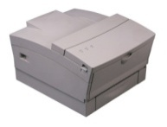




Typical Application of a DEMUX
Single Source
Selector
Multiple Destinations
B/W Laser
Printer
Fax
Machine
D0
D1
D2
D3
X
DEMUX
Color Inkjet
Printer
B | A | Selected Destination
0 | 0 | B/W Laser Printer
0 | 1 | Fax Machine
1 | 0 | Color Inkjet Printer
1 | 1 | Pen Plotter
Pen
Plotter
Notes:
This slide shows a typical application of a demultiplexer (in this case a 1-to-4 DEMUX). Ask students to share other common applications of DEMUXs.
Multiplexers & Demultiplexers
Digital Electronics™
Lesson 2.4 – Specific Combo Circuits & Misc Topics
Project Lead The Way, Inc.
Copyright 2009

Slide 5
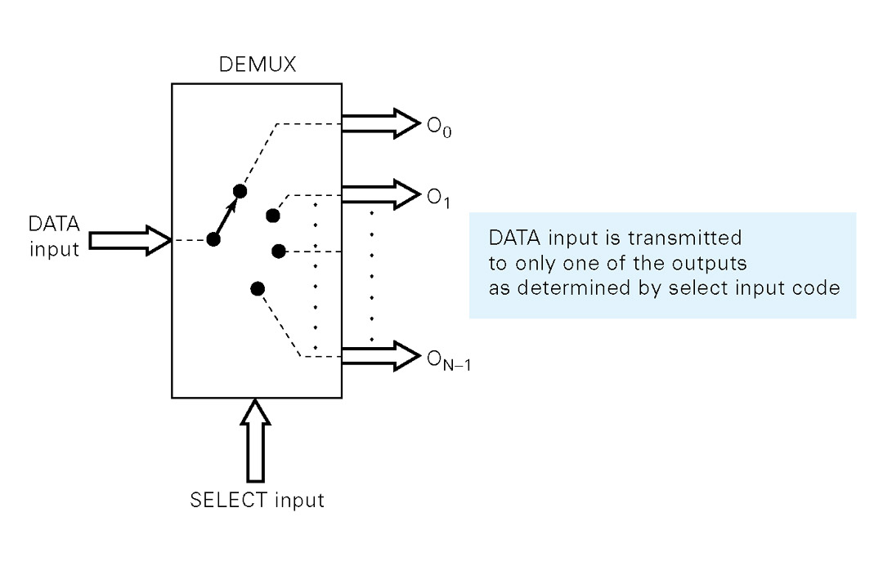
General demultiplexer
Functional diagram:-
The large arrow indicates one or more lines. The select i/p code determines to which output the DATA input will be transmitted
In other words, the demultiplexer takes one data input source and selectively distributes it to 1 of N output channels just like multiposition switch.

Slide 6
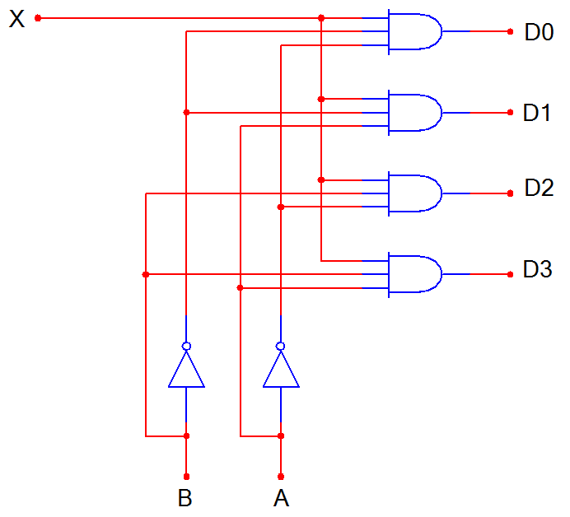
1-to-4 De-Multiplexer (DEMUX)
D0
D1
D2
D3
X
DEMUX
B A
B | A | D0 | D1 | D2 | D3
0 | 0 | X | 0 | 0 | 0
0 | 1 | 0 | X | 0 | 0
1 | 0 | 0 | 0 | X | 0
1 | 1 | 0 | 0 | 0 | X
Notes:
SSI logic diagram, block diagram, and truth table for a 1-to-4 De-MUX
Multiplexers & Demultiplexers
Digital Electronics™
Lesson 2.4 – Specific Combo Circuits & Misc Topics
Project Lead The Way, Inc.
Copyright 2009

Slide 7
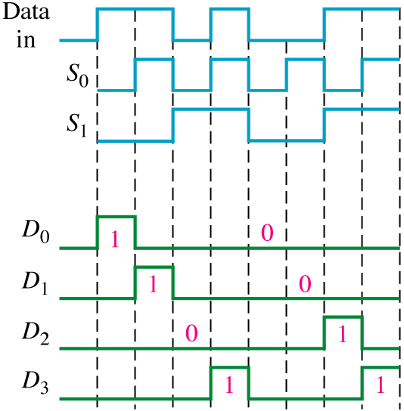
The serial data input waveform (Data in) and data select inputs (S_{o} and S₁) and
the corresponding data output waveforms (D₀ through D₃) are shown below

